Slide 1
Lesson objective
PBiS focus
Respect – listening
Achieve – seek feedback or help
Title: Topic review 1
Aim – be able to:
Match sequences from tables to appropriate graphs
Create rules and plot from a table of values
Plan:
Time distance graphs
Plotting
Need whiteboards

Slide 2
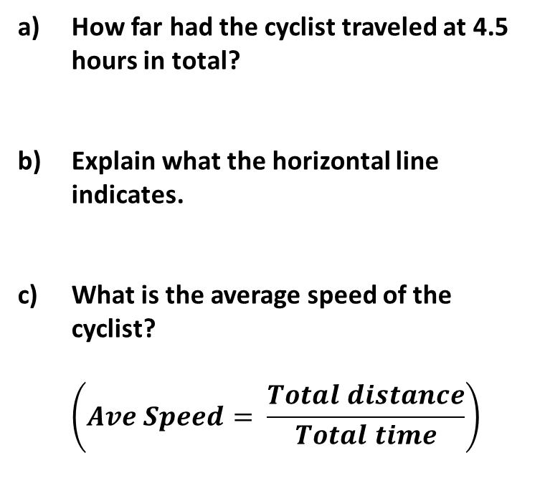
The graph shows a cyclist’s journey, from home, to a café and back.
40
How far had the cyclist traveled at 4.5 hours in total?
Explain what the horizontal line indicates.
What is the average speed of the cyclist?
$$\left(Ave Speed= \frac{Total distance}{Total time}\right)$$
30
Distance from home (miles)
20
10
0
0
1
2
3
4
5
6
7
Time (hours)

Slide 3
Five distance-time graphs are shown.
Each box below describes one graph.
Write the letter of the correct graph next to its description.
Q5
Graph C
Distance
from
home
Solution
Distance
from
home
Graph A
1 | Khalid walked home slowly from his friend’s house.
2 | Natalie walked steadily to the park.
Time
Time
Distance
from
home
Graph E
3 | Sophie walked to school, stopped to look at her watch, realised she was late and then started running.
5 | Michael went out with his friends, realised he had left his wallet at home. He ran home to get it and then ran again to catch up with his friends.
Graph B
Distance
from
home
Graph D
Time
Distance
from
home
4 | David walked to his local gym. Stayed there for a workout and then ran home.
Time
Time
Notes:
Question inspired by CorbettMaths!

Slide 4
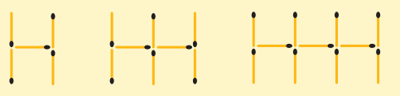
Demonstration
Draw the next shape
Make a table of values
Create a rule
Determine 20th pattern
Plot
Number of shapes | 0 | 1 | 2 | 3 | 4
Number of matches
RULE:____________________
20 shapes……

Slide 5
Line Graphs
The equation of a straight line in slope intercept form is:
y = mx + c
Where: x and y are different variables
m is the gradient
c is the y-intercept (when x = 0)

Slide 6

Table of values
X | 1 | 2 | 3 | 4
Y | 6 | 9 | 12 | 15
Using a table of values we can also determine the rule.
M is the rate of change (aka common difference)
C is the y-intercept (what is the value of x at this point?)
$$y=mx+c$$

Slide 7
Table of values
X | 0 | 1 | 2 | 3
Y | 12 | 6 | 0 | -6
Using a table of values we can also determine the rule.
M is the rate of change
C is the y-intercept (what is the value of x at this point?)
$$y=mx+c$$

Slide 8
**Table of values**
X | 0 | 2 | 4 | 6
Y | 2 | 10 | 18 | 26
Using a table of values we can also determine the rule.
M is the rate of change
C is the y-intercept (what is the value of x at this point?)
$$y=mx+c$$

Slide 9
Whiteboards

Slide 10
Whiteboards – write the equation
X | 0 | 1 | 2 | 3
Y | 3 | 6 | 9 | 12
Using a table of values we can also determine the rule.
M is the rate of change
C is the y-intercept (what is the value of x at this point?)
$$y=mx+c$$

Slide 11
Whiteboards – write the equation
X | 0 | 1 | 2 | 3
Y | 12 | 18 | 24 | 30
Using a table of values we can also determine the rule.
M is the rate of change
C is the y-intercept (what is the value of x at this point?)
$$y=mx+c$$

Slide 12
Whiteboards – write the equation
X | 1 | 2 | 3 | 4
Y | 5 | 9 | 13 | 17
Using a table of values we can also determine the rule.
M is the rate of change
C is the y-intercept (what is the value of x at this point?)
$$y=mx+c$$

Slide 13
Whiteboards – write the equation
X | 0 | 1 | 2 | 3
Y | 7 | 5 | 3 | 1
Using a table of values we can also determine the rule.
M is the rate of change
C is the y-intercept (what is the value of x at this point?)
$$y=mx+c$$

Slide 14
**Table of values**
X | 0 | 2 | 4 | 6
Y | 1 | 7 | 13 | 19
Using a table of values we can also determine the rule.
M is the rate of change
C is the y-intercept (what is the value of x at this point?)
$$y=mx+c$$

Slide 15
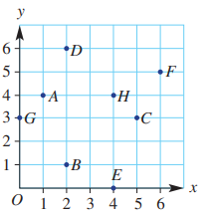
Where are they?
Example:
A (1, 4)
Whiteboards
Write the coordinates of:
B
H
E
C

Slide 16


Input | 1 | 2 | 3 | 4 | 5
Output | 4 | 8 | 12 | 16 | 18
This patterns is
L_______
Does it make sense to connect the dots?

Slide 17
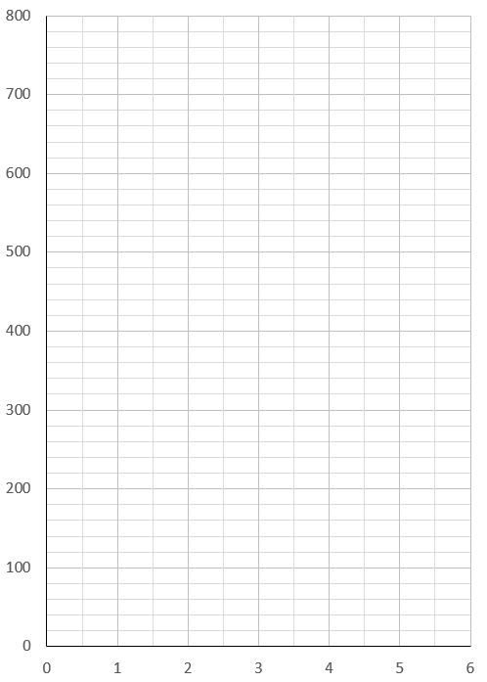
Describing graphs
This graph shows how much Sally is paid.
Does it make sense to connect the dots?
Hours | 1 | 2 | 3 | 4 | 5 | 6
$$ | 80 | 160 | 240 | 320 | 400 | 480

Slide 18
Match the line to the table of values.
X | 0 | 1 | 2 | 3
y | 1 | 2 | 3 | 4
X | 1 | 2 | 3 | 4
y | 2 | 4 | 6 | 8

Slide 19
Practice task/homework
Complete puzzle sheet from yesterday!

